Slide 1
IBM University Engagement Project Submission
“Exploring the Power of Agentic AI with IBM Granite and IBM Bob”

Slide 2

Project Tile – The Manufacturing Process Quality Control Agent
Domain of Project – Agriculture
Student Name | Recent Passport Photo | Email ID | Mobile number [WhatsApp]
Sudha Singh Rajput |  | rajputsudha034@gmail.com | 7489948377

Slide 3
Problem Statement -
Problem Statement: Manufacturing Process Quality Control Agent
The Challenge
Manufacturing quality can be affected by variations in temperature, pressure, machine calibration, and material properties. Traditional manual inspections are time-consuming and may detect defects too late. An intelligent system is needed to monitor processes continuously and predict defects early.
Objective
Build an AI-powered Manufacturing Quality Control Agent that monitors production parameters in real time, detects anomalies, predicts defects, and recommends corrective actions.
Key Features
.RAG-Based Data Retrieval – Retrieves machine data, SOPs, inspection records, and quality information.
.Defect Detection – Identifies abnormal process patterns.
.Quality Prediction – Predicts potential defects before they occur.
.Process Optimization – Recommends suitable process adjustments.
.AI Quality Insights – Generates actionable reports for engineers.
.Multi-Agent System
.Process Monitoring Agent – Monitors machine and sensor data.
.Quality Analysis Agent – Detects anomalies and quality deviations.
.Defect Prediction Agent – Predicts potential defects.
.Optimization Agent – Suggests corrective actions.
.Visualization Dashboard
Displays real-time production metrics, defect alerts, quality trends, risk scores, and AI recommendations through an interactive dashboard.
Mandatory Tech Stack
IBM Langflow / IBM Orchestrate + IBM Models

Slide 4
Proposed Solution -
Proposed Solution — AI-Powered Manufacturing Quality Control Agent
SmartQ-Forge is an AI-powered, multi-agent quality intelligence platform that continuously monitors manufacturing processes, detects abnormal patterns, predicts defects before production loss occurs, and recommends corrective actions in real time.
The system combines real-time sensor/machine data, historical production records, inspection reports, and manufacturing knowledge through RAG to create a unified quality intelligence layer.
How It Works:-
1. Process Monitoring Agent Continuously analyzes machine parameters such as temperature, pressure, vibration, speed, and material conditions to identify deviations.
2. Quality Analysis Agent Uses AI-driven anomaly detection to correlate process variations with historical quality and inspection data.
3. Defect Prediction Agent Predicts the probability and type of upcoming defects, providing an early-warning Quality Risk Score before defective products are produced.
4. Process Optimization Agent Recommends actionable parameter adjustments and corrective measures to engineers while considering production and quality constraints.
5. RAG-Based Quality Intelligence Retrieves relevant SOPs, quality standards, machine manuals, inspection records, and past incidents to provide evidence-backed recommendations rather than generic AI responses.
6. Quality Command Dashboard Provides real-time visibility into machine health, production quality, defect risk, anomaly alerts, quality trends, root causes, and recommended actions.

Slide 5
Technology Used
• IBM Bob Platform – For designing and orchestrating multi-agent workflows visually.
• IBM Granite Model – For AI reasoning, quality analysis, and intelligent recommendations.
• IBM Cloud – For secure, scalable deployment of the Quality Control Agent.
• RAG – To retrieve relevant manufacturing data, SOPs, manuals, and inspection records before generating responses.
• IBM watsonx.ai – For AI model deployment, embeddings, evaluation, and governance.
• Vector Database (FAISS/ChromaDB) – For fast retrieval of manufacturing knowledge and historical records
.
• Python + Machine Learning – For anomaly detection, defect prediction, and quality-risk scoring.
• React.js + FastAPI – For the interactive quality dashboard and backend APIs.

Slide 6
Required Files created using IBM bob -
1. app.py – Main application / API entry point
2. requirements.txt – Required Python libraries
3.style.css – Dashboard styling
4 .env – API keys and environment configuration
5. index.html – Web dashboard interface
6. agents.py – Multi-agent workflow and agent coordination
7. rag.py – Manufacturing document retrieval using RAG
8. quality_model.py – Anomaly and defect prediction logic
9. dashboard.js – Real-time quality metrics and alerts

Slide 7
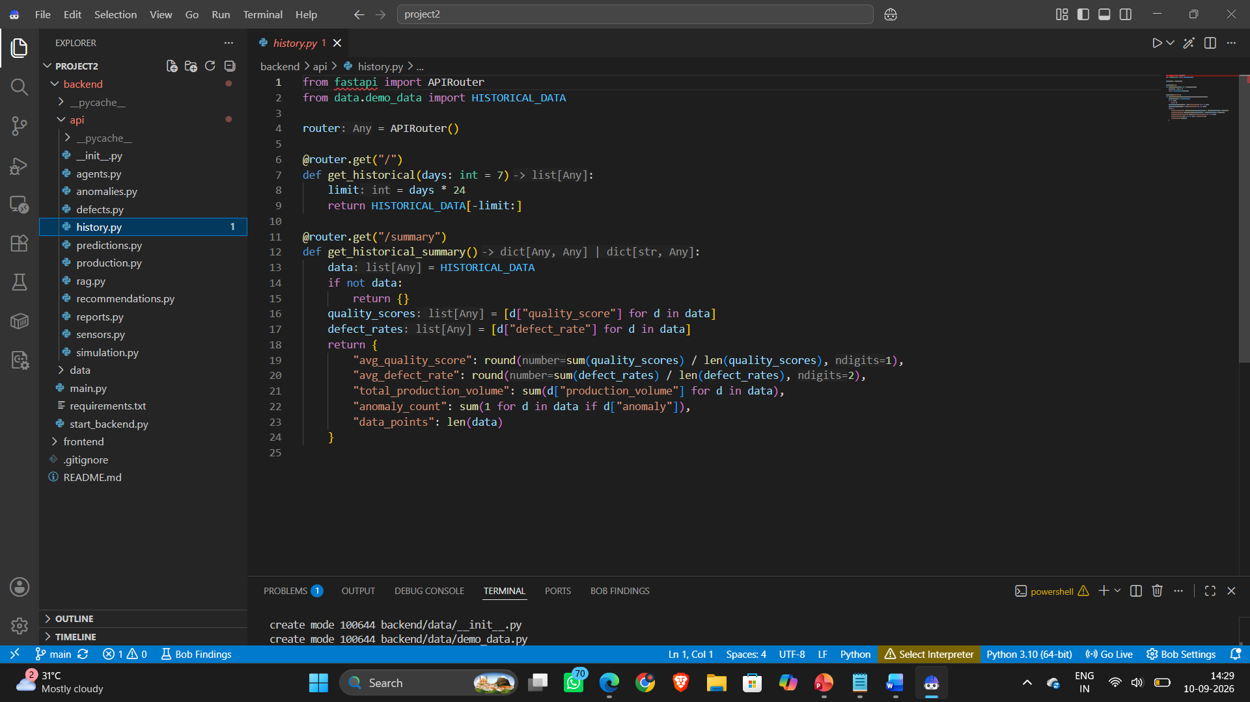
IBM Bob Screenshots:

Slide 8

Role of Agentic AI in the solution
• Autonomous Monitoring Agent – Continuously monitors machine and sensor data to identify abnormal conditions.
• Quality Analysis Agent – Analyzes process variations and determines potential quality deviations.
• Defect Prediction Agent – Predicts the likelihood of defects using historical and real-time production data.
• Optimization Agent – Recommends corrective actions such as adjusting temperature, pressure, speed, or other process parameters.
• AI Reporting Agent – Automatically generates quality insights, alerts, and reports for production engineers.
Overall Role: Agentic AI connects these specialized agents into a continuous Monitor → Analyze → Predict → Optimize → Report loop, enabling proactive quality control instead of reactive inspection.

Slide 9
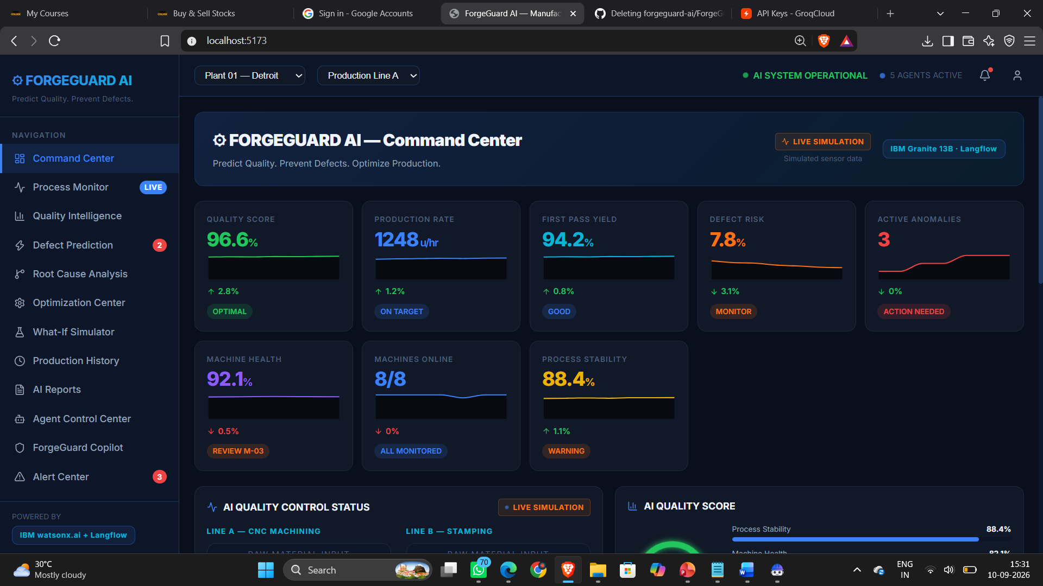
Project Output Screenshot
Please put IBM Bob output screenshots with 2-3 prompts.
You can take 2-3 more slides for each screenshot
·
·
·

Slide 10
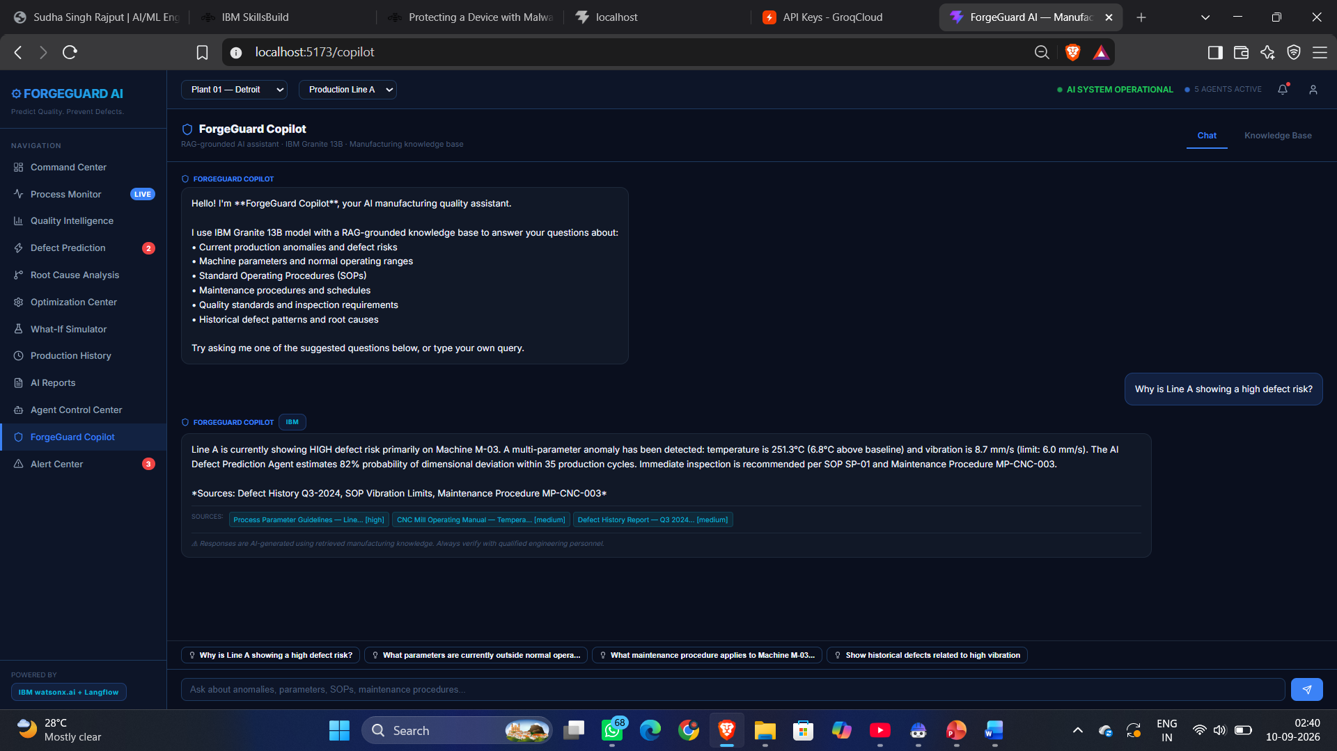
Project Output Screenshot
Please put IBM Bob output screenshots with 2-3 prompts.
You can take 2-3 more slides for each screenshot
·
·
·

Slide 11
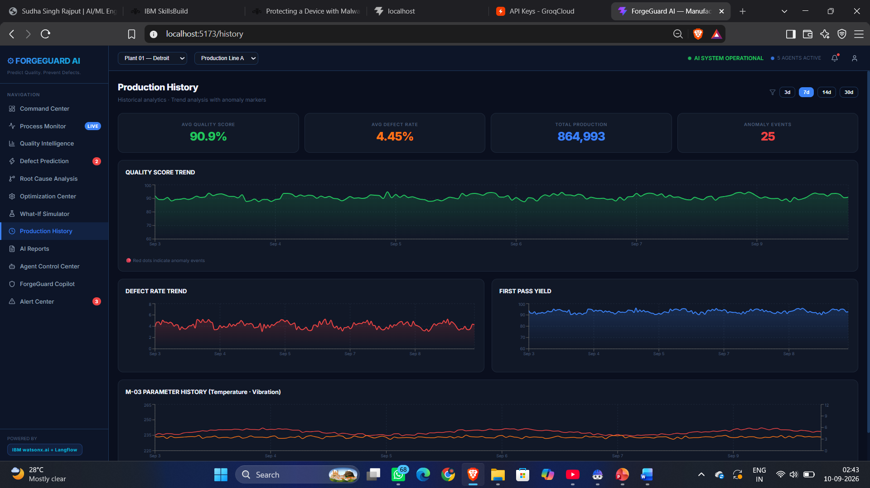
Project Output Screenshot
Please put IBM Bob output screenshots with 2-3 prompts.
You can take 2-3 more slides for each screenshot
·
·
·

Slide 12
Novelty and Uniqueness
• Proactive Quality Control – Predicts defects before production failures occur, rather than relying only on final inspection.
• Multi-Agent Intelligence – Specialized AI agents collaborate to monitor, analyze, predict, optimize, and report quality issues.
• AI Root-Cause Insights – Identifies likely causes behind quality deviations by connecting machine parameters, material data, and historical records.
• RAG-Powered Recommendations – Uses manufacturing SOPs, machine manuals, quality standards, and past inspection records to provide context-aware corrective actions.
• Dynamic Risk Scoring – Generates a continuously updated Quality Risk Score for machines and production processes.
• Human-in-the-Loop – Engineers remain in control by reviewing and approving AI recommendations before critical process changes.
Unique Value: A shift from “Detect Defects After Production” → “Predict, Prevent & Optimize Quality Before Defects Occur.”

Slide 13
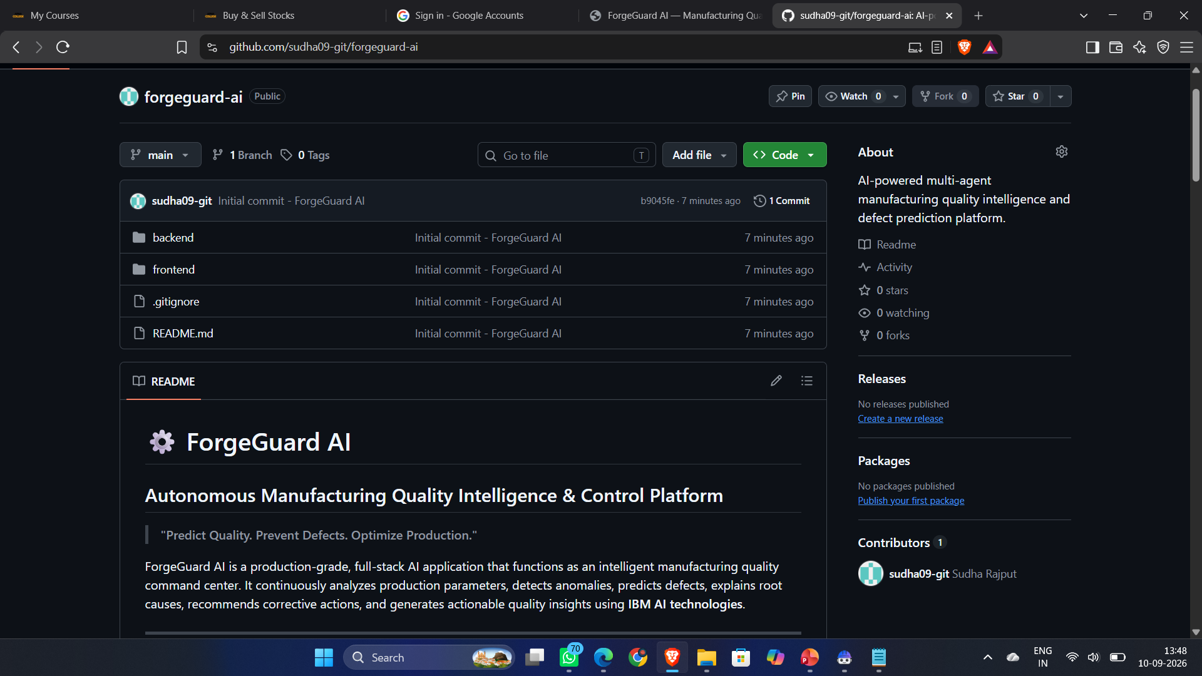
Git Hub Link
Github URL – https://github.com/sudha09-git/forgeguard-ai.git
·
·
·

Slide 14
Future Scope
• IoT & Computer Vision Integration – Integrate industrial IoT sensors and camera-based vision systems for real-time monitoring and automated detection of machine abnormalities, surface defects, and dimensional errors.
• Predictive Maintenance – Extend the platform to predict machine failures in advance, enabling timely maintenance and reducing unexpected downtime and production losses.
• Digital Twin & Autonomous Optimization – Introduce digital-twin technology to simulate process changes and allow AI agents to identify optimal production parameters for safer, more efficient, and consistent manufacturing.
·
·
·

Slide 15
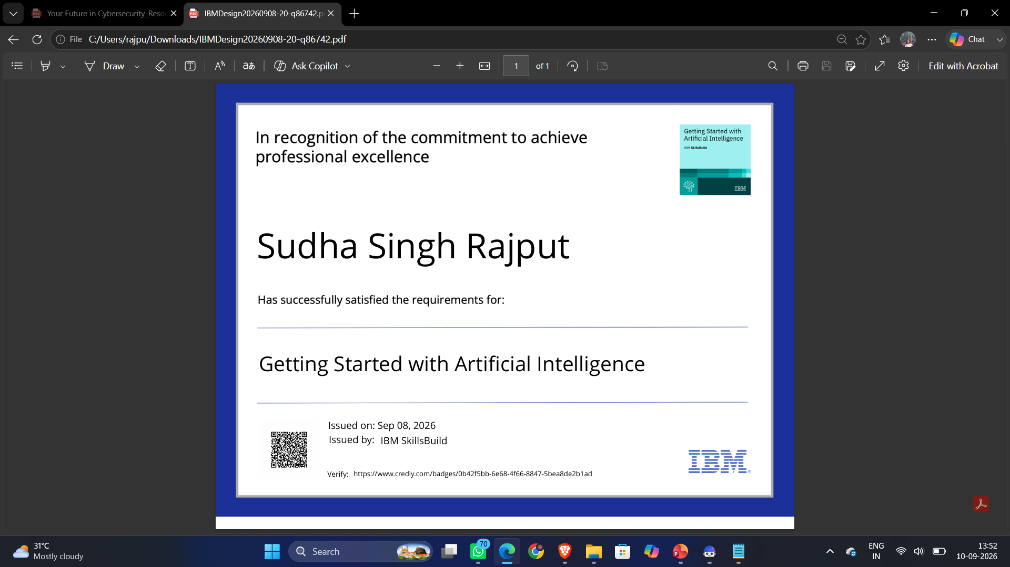
Certificates Earned:

Slide 16
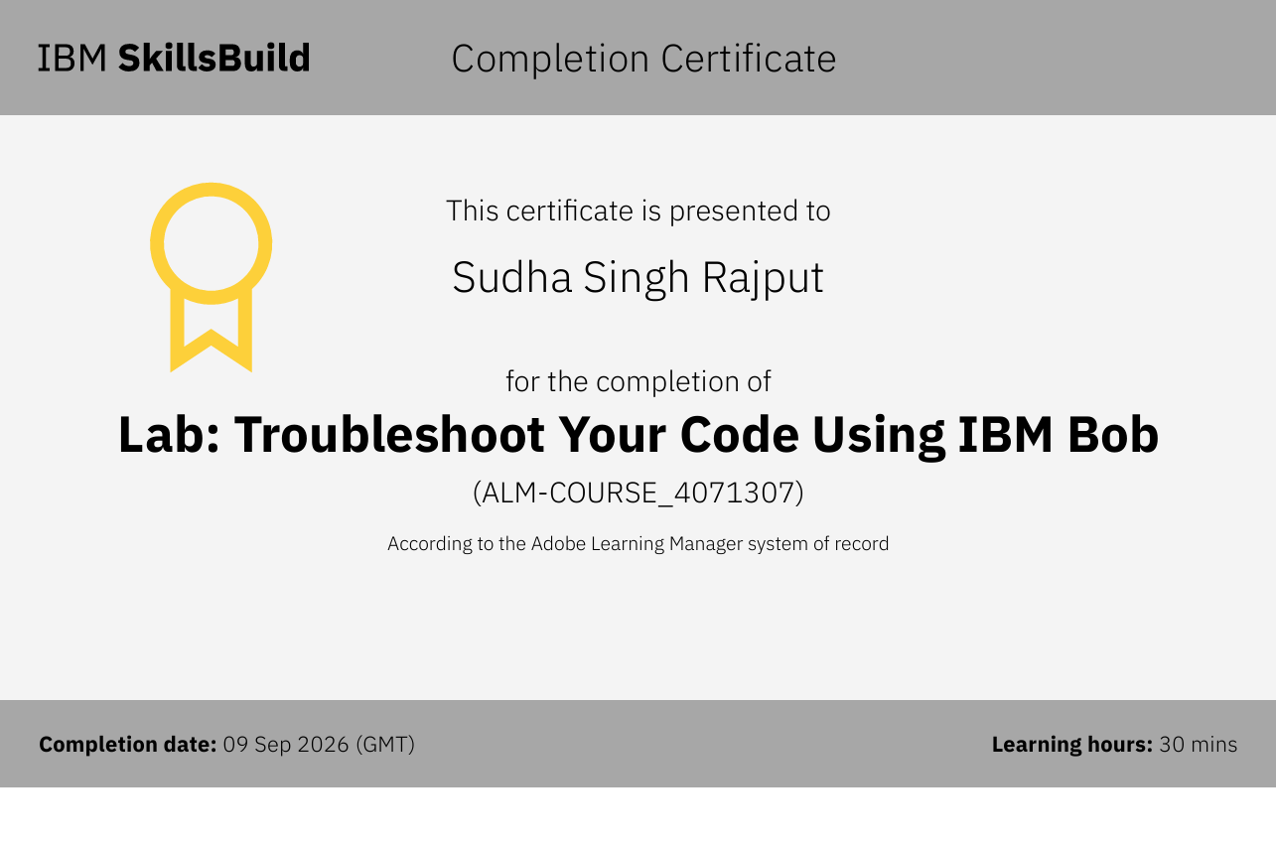
Certificates Earned:​

Slide 17


